Slide 1
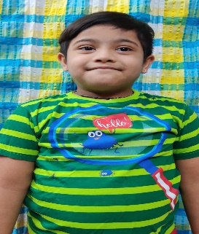
CASE STUDY
CHILD WITH DOWN SYNDROME
VAIBHAV
Vaibhav is a cheerful and pleasant 8yr old child, diagnosed with down syndrome, he joined DIVYA DOWNS DEVELOPMENT TRUST in the year 2018.Vaibhav has no behavior problems. He is a sensible child and well managed at home. He has very good potential to improve.
BASIC DETAILS OF CHILD AND FAMILY
OTHER HOUSEHOLD MEMBERS
Childs name – Vaibhav | Sex DOB – M : 9/9/2012
Address: #26,1ST cross, Venugopal Swamy lyt ejipura, Bangalore 560047 | Phone:
Father name : Shankar lagumaiah | Occupation CSR
Fathers work address : manyatha tech park | Phone:
Mothers name: Bhagya | Occupation: NIL
Mothers work address : HOUSE WIFE | Phone: NIL
NAME | AGE | RELATIONSHIP
Elder brother 1 | 12 | Brother
Younger brother 1 | 3 | Brother
PRIMARY LANGUAGE: Kannada

Slide 2
BASE LINE DATA of Vaibhav
Gross Motor skills | He was unable to climb stairs and mount on an exercise cycle by himself. He also found it very difficult to use his legs for kicking a ball.
Fine Motor | Vaibhav Fine motor skills too were not refined. His finger movements were not adequate enough to do any work using fingers. He was unable to pick up objects using the thumb and index finger. Threading bead was very difficult for him, eat using a spoon, write and throw a ball.
Self Help | Vaibhav was unable to wear a shirt, do the buttoning and wear shoes by himself. He also found it difficult to brush teeth, wash hands-face, bathe and attend to toilet needs independently.
Speech | Vaibhav was not able to speak in English. He found it difficult to understand instructions in English.
Language and communication Receptive and expressive | Vaibhav had difficulty in comprehension. He was not able to follow a twostep direction and perform accordingly, He was unable to follow a story and answer to simple questions in proper sentences.
Reading and writing skills | His reading skills were not well developed. He had difficulty in reading sight words, opposites, action words, His writing skills were also not well developed.
Number skills | Vaibhav was unable to write numbers. His counting skills were very poor.
Social skills | He had good social skills but was unable to express verbally words like good morning, thank you, please and sorry
AFTER IMPLIMENTATION OF THE PROGRAMME THE FOLLOWING CHANGES WERE NOTICED IN THE FOLLOWING SKILL AREAS------------(IMPROVEMENTS)
Due to the Pandemic all classes are taken via WhatsApp, demo videos and worksheets. The students have gradually got adjusted to the new way of teaching and are now enjoying the teaching sessions.

Slide 3
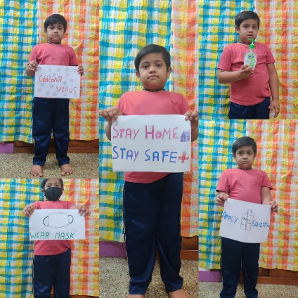
Gross Motor skills | With the physiotherapy given Vaibhav showed improvement in his gross motor activities such as climbing upstairs, mounting up the exercise cycle, cycling, throwing a ball , and kicking a ball
Fine Motor Skills | Through proper guidance and regular finger exercise Vaibhav has learnt to Thread beads, use thumb and index finger for picking objects, write, eat using spoon and drink water from a bottle.
Self Help | Vaibhav has learnt to wear a shirt independently. Button and unbutton with minimum assistance, bathe with little help, brush teeth, wash hands and face independently.
Speech | After the implementation of speech, he learnt to speak in English. He can pronounce few animals, birds, fruits, vegetables, colours.
ADL(activities of daily living) | Vaibhav was taught to do simple house hold duties such as keeping plates and tumblers on dining table before meals. He learnt to do it well and now.
Language and communication Receptive and expressive | Vaibhav has shown tremendous improvement in comprehension. He follows twostep direction well and performs accordingly, He is now able to follow a story and answer to simple questions orally.
Reading and writing skills | He learnt to read well now. He learnt to read all sight words, action words, opposites. He is learnt to match objects to appropriate letters.
Number skills | Vaibhav learnt to write numbers 1 to10, He has shown improvement in counting skills as well. And matching numbers.
Social skills | Vaibhav developed his social skills. He now greets people using appropriate words such as Good morning, hello, hi. He also uses thank you and sorry.
Art Craft | Vaibhav learnt drawing and colouring. He enjoys the Origami art.
Vaibhav has learnt covid safety measures
Wash hands with soap, sanitize hands , wear mask while going out and stay home n stay safe.
A small video of he tell “om namah shivay”
A small video of covid safety measure
Which I thought him.

